Slide 1
MS Access

Slide 2
SQL INSERT INTO Statement
It is possible to write the INSERT INTO statement in two forms.
The first form does not specify the column names where the data will be inserted, only their values:
INSERT INTO table_name VALUES (value1,value2,value3,...);
The second form specifies both the column names and the values to be inserted:
INSERT INTO table_name (column1,column2,column3,..) VALUES (value1,value2,value3,...);

Slide 3
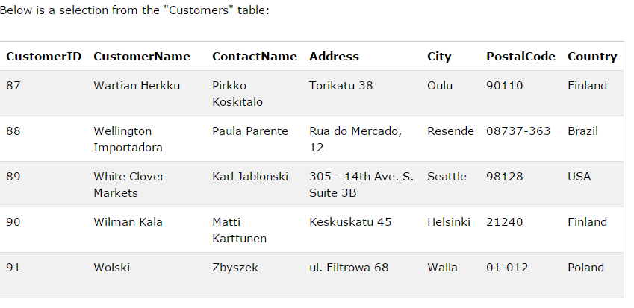

Slide 4
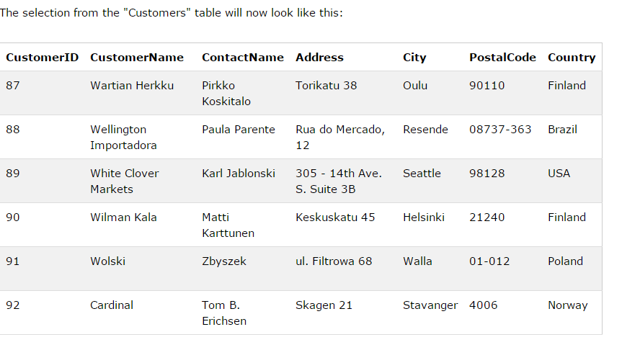
INSERT INTO Customers (CustomerName, ContactName, Address, City, PostalCode, Country) VALUES ('Cardinal','Tom B. Erichsen','Skagen 21','Stavanger','4006','Norway');

Slide 5
The SQL UPDATE Statement
UPDATE table_name SET column1=value1,column2=value2,... WHERE some_column=some_value;

Slide 6
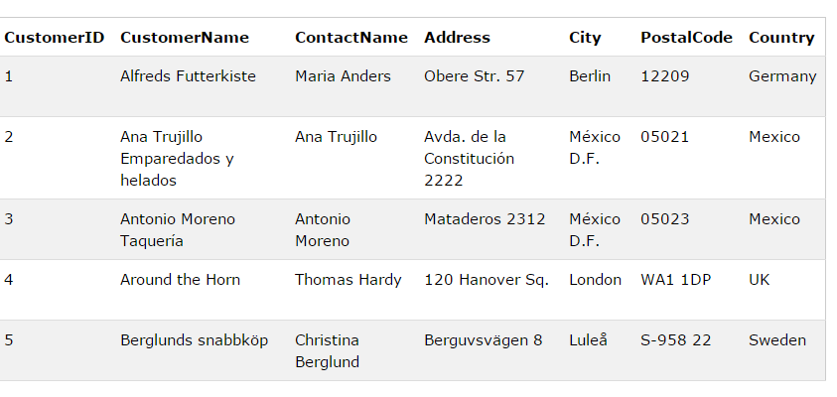

Slide 7
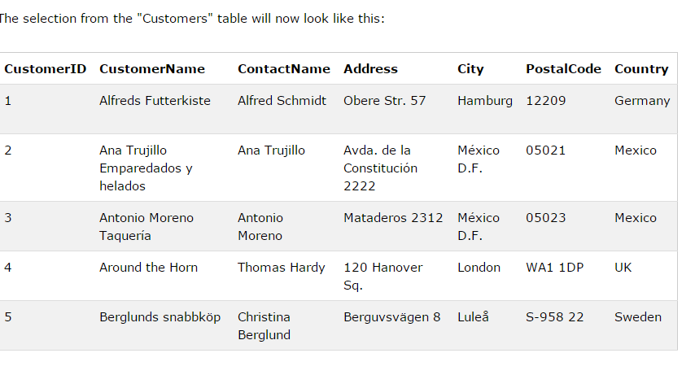
UPDATE Customers SET ContactName='Alfred Schmidt', City='Hamburg' WHERE CustomerName='Alfreds Futterkiste';

Slide 8
The SQL DELETE Statement
DELETE FROM table_name WHERE some_column=some_value;
DELETE FROM Customers WHERE CustomerName='Alfreds Futterkiste' AND ContactName='Maria Anders';
DELETE FROM table_name; or DELETE * FROM table_name;

Slide 9
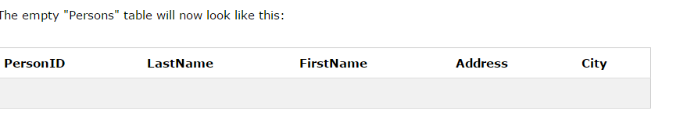
The SQL CREATE TABLE Statement
CREATE TABLE table_name ( column_name1 data_type(size), column_name2 data_type(size), column_name3 data_type(size), .... );
CREATE TABLE Persons ( PersonID int, LastName varchar(255), FirstName varchar(255), Address varchar(255), City varchar(255) );

Slide 11
The DROP TABLE Statement
The DROP TABLE statement is used to delete a table.
DROP TABLE table_name;

Slide 12
The TRUNCATE TABLE Statement
Delete the data inside the table, and not the table itself.
Then, use the TRUNCATE TABLE statement:
TRUNCATE TABLE table_name

Slide 13
SQL ALTER TABLE Statement
The ALTER TABLE statement is used to add, delete, or modify columns in an existing table.
Syntax
To add a column in a table, use the following syntax:
ALTER TABLE table_name ADD column_name datatype
To delete a column in a table, use the following syntax (notice that some database systems don't allow deleting a column):
ALTER TABLE table_name DROP COLUMN column_name
To change the data type of a column in a table, use the following syntax:
ALTER TABLE table_name ALTER COLUMN column_name datatype

Slide 14
SELECT DISTINCT column_name,column_name FROM table_name;
SELECT DISTINCT City FROM Customers;

